Slide 1
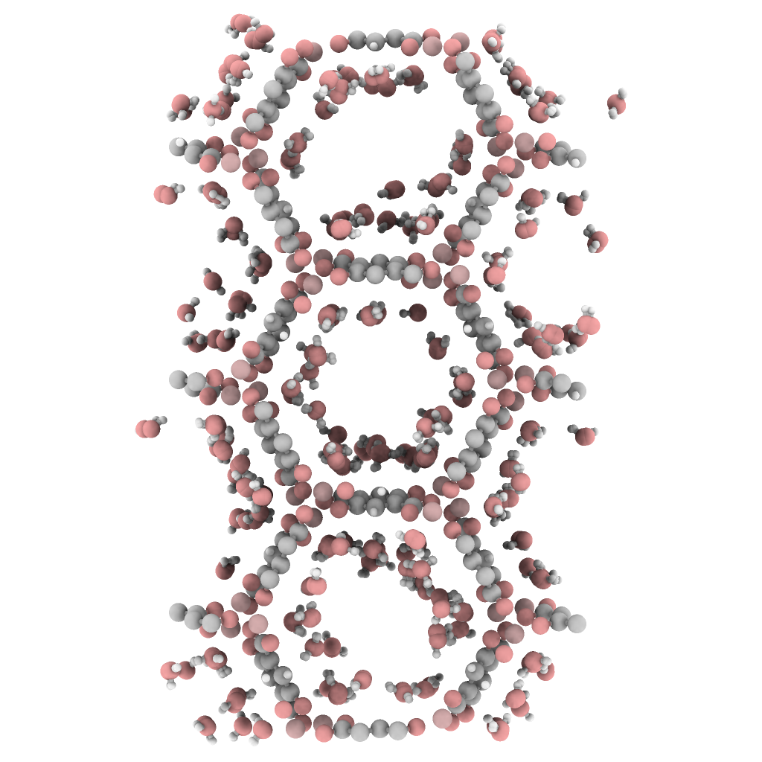
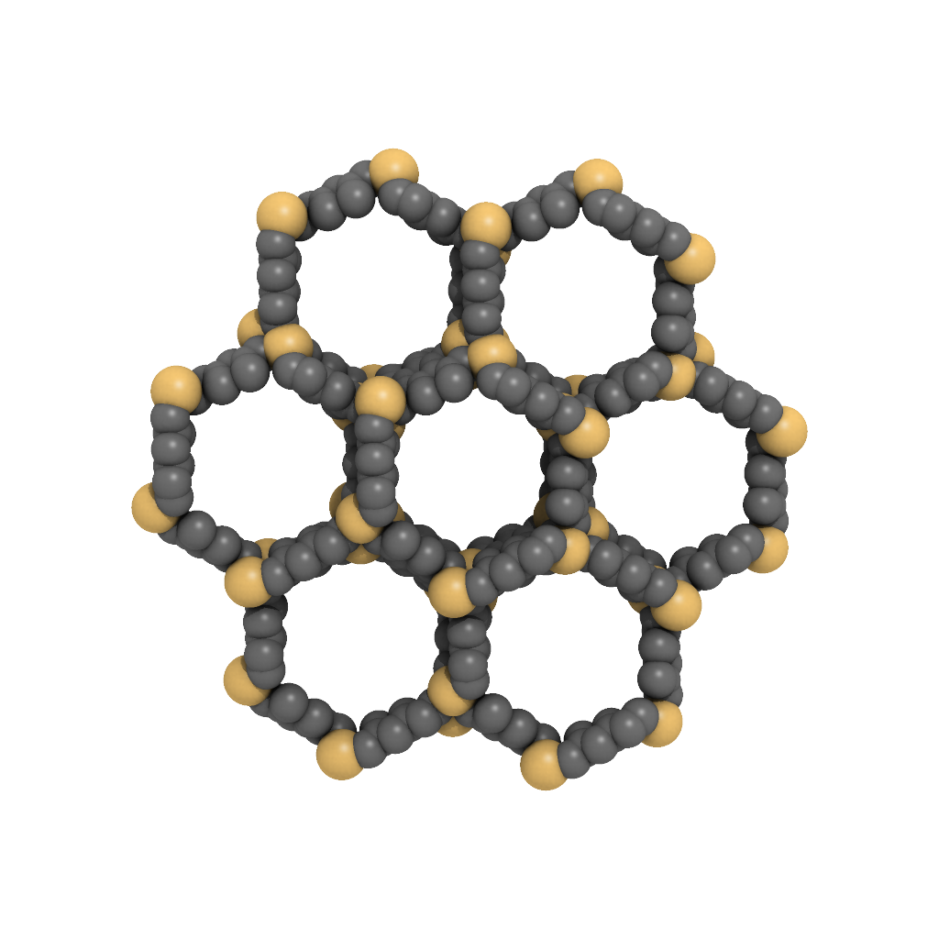
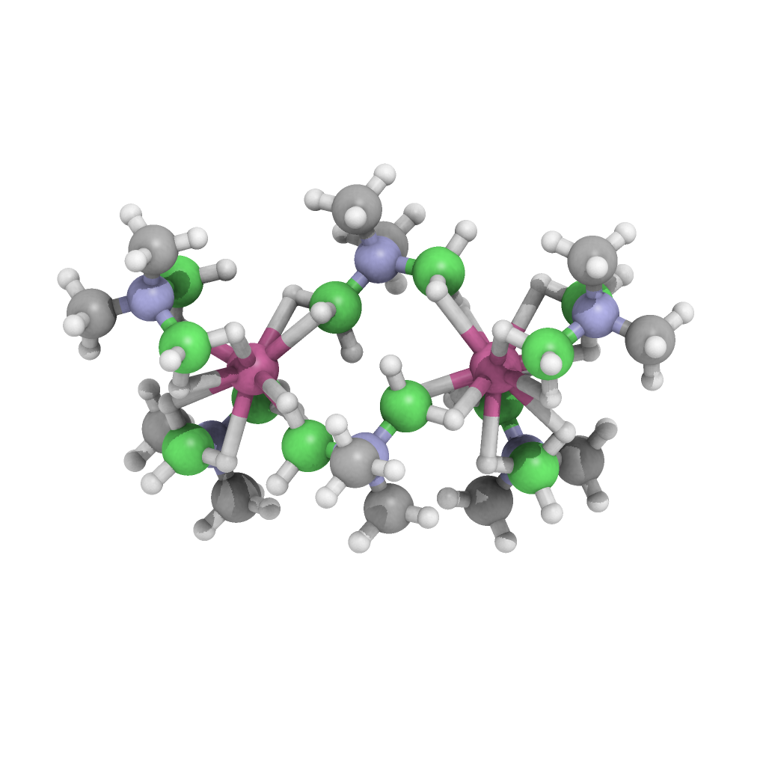
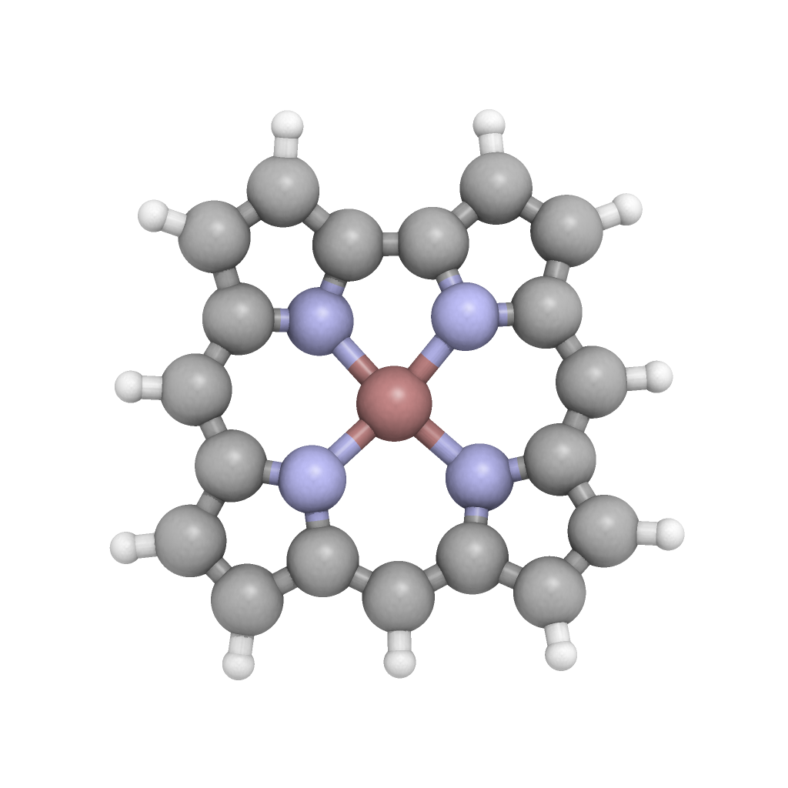
Molecular Simulations
Periodic DFT
DFT
Post HF methods
Accuracy of the Energy
System Size / Configurations Sampled

Slide 2
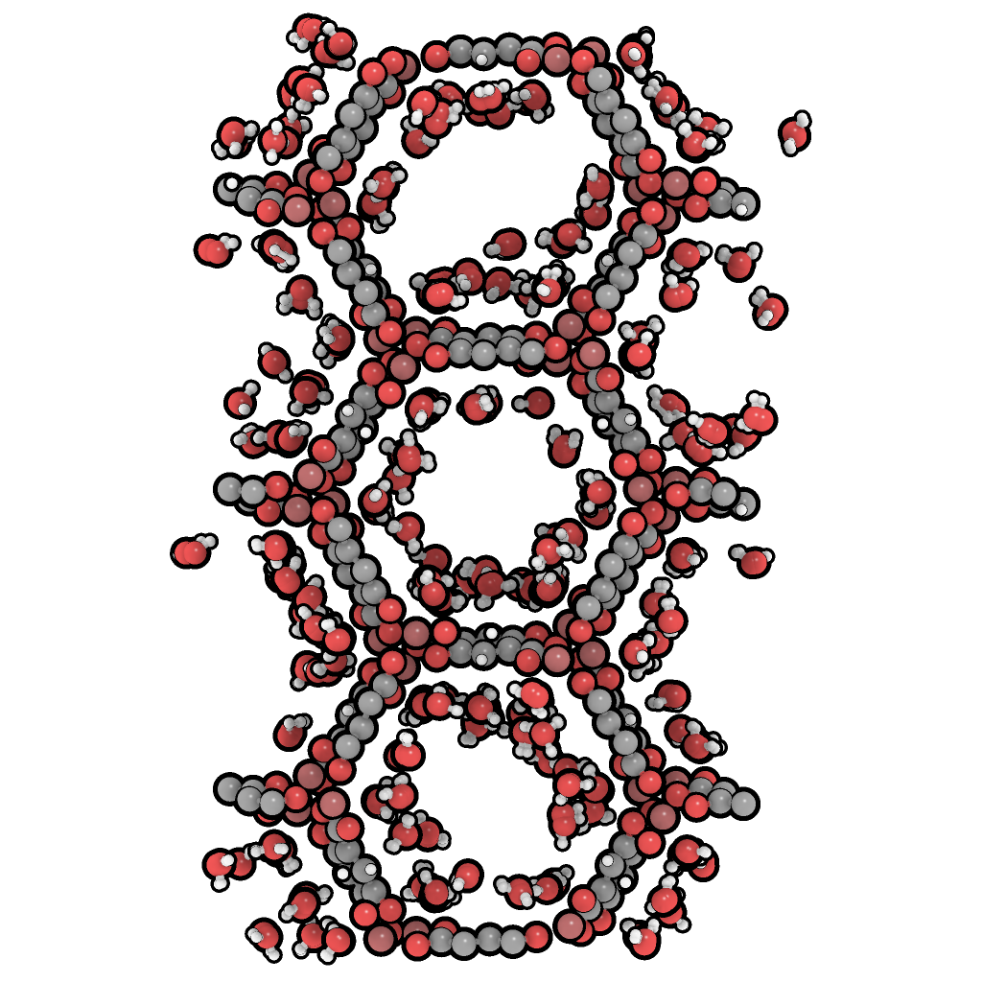
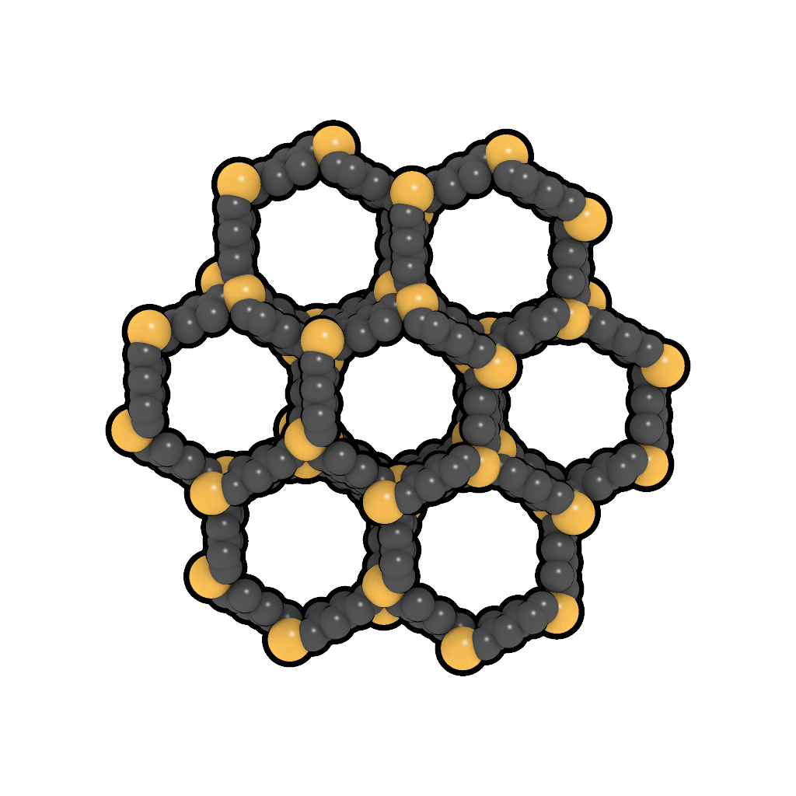
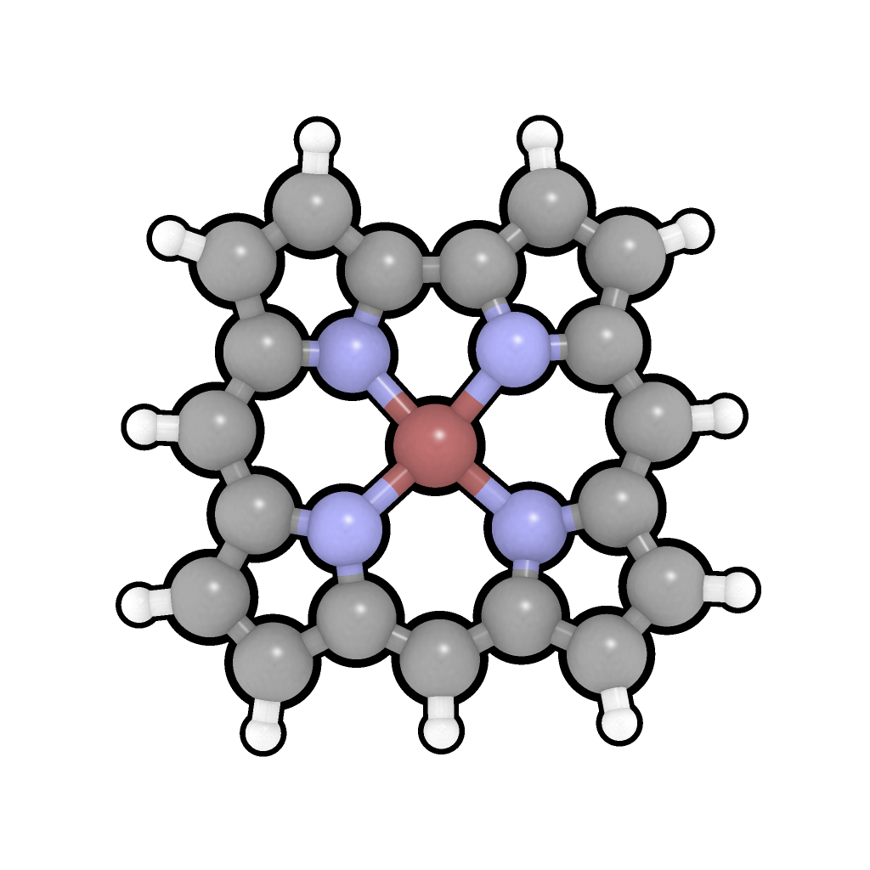
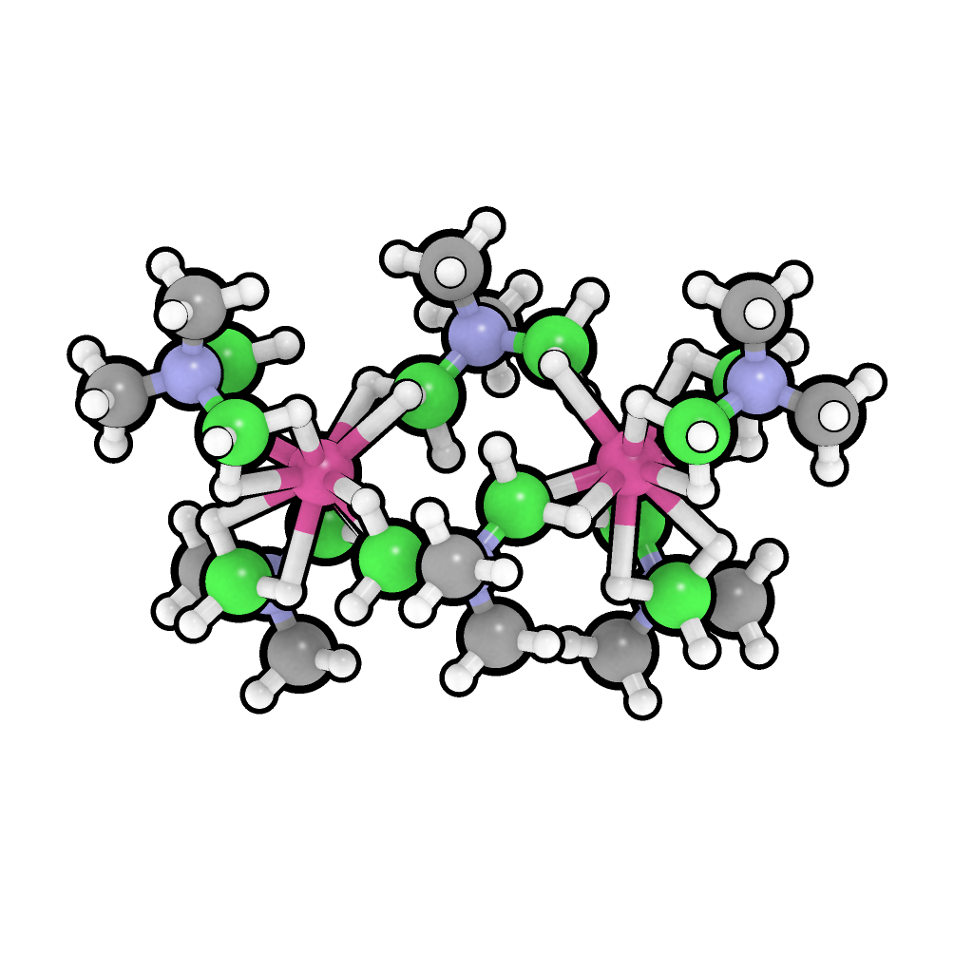
Molecular Simulations
Post HF methods
Periodic
DFT
DFT
Accuracy of the Energy
System Size / Configurations Sampled

Slide 3
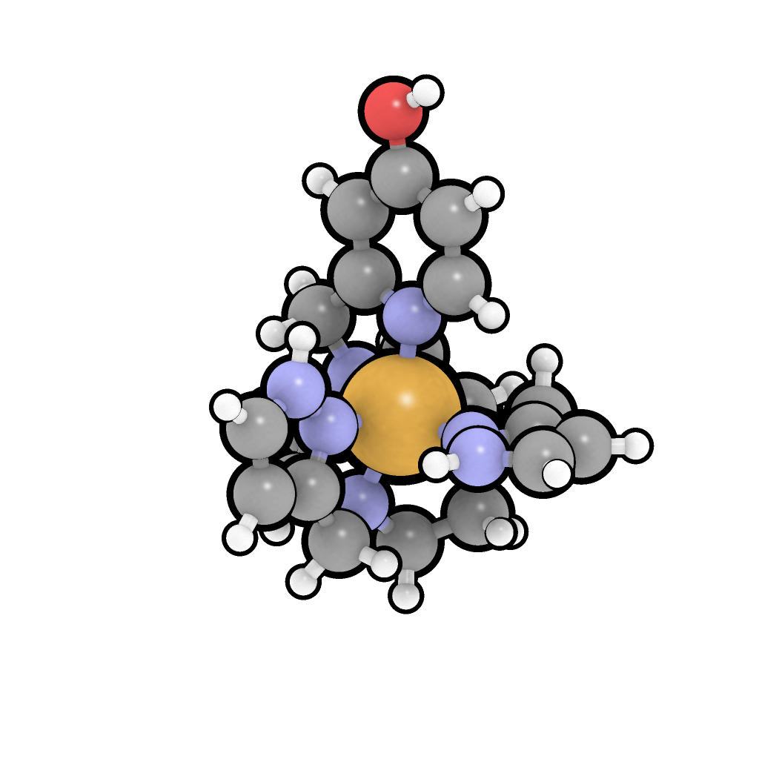
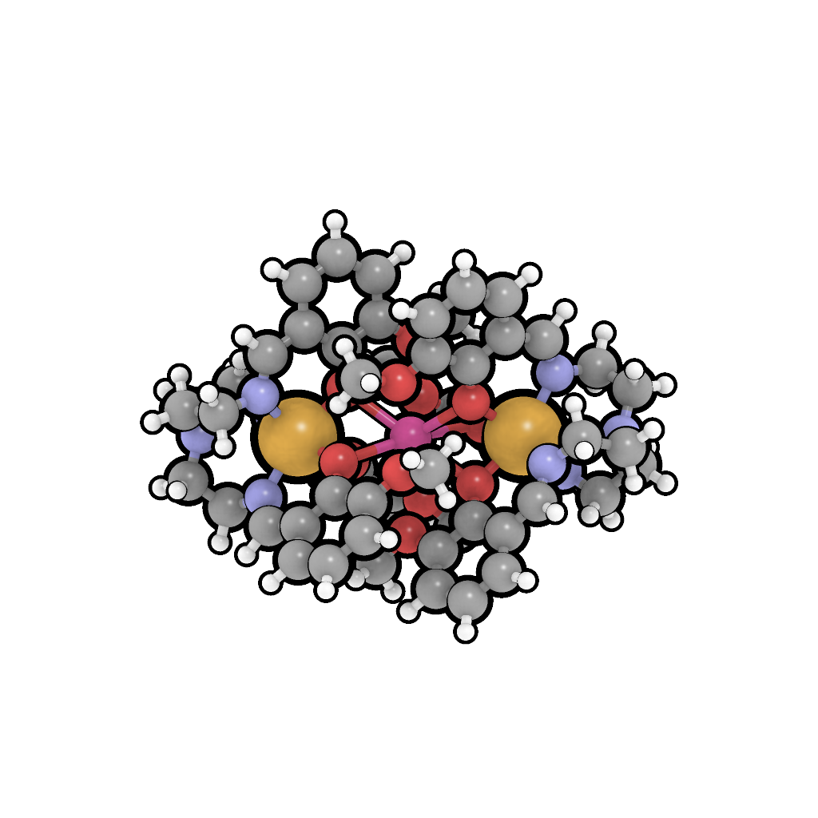
M
M
M
M
Lanthanide and Actinide Complexes
Single Molecule Magnets
Bioprobes / Photosensors
Effect of Non-Innocent Ligands
Metal Clusters
Covalent Interactions Between Metals
Multi-metallic catalysts
Model Enzyme active sites

Slide 4
U
U
U
U

Slide 5
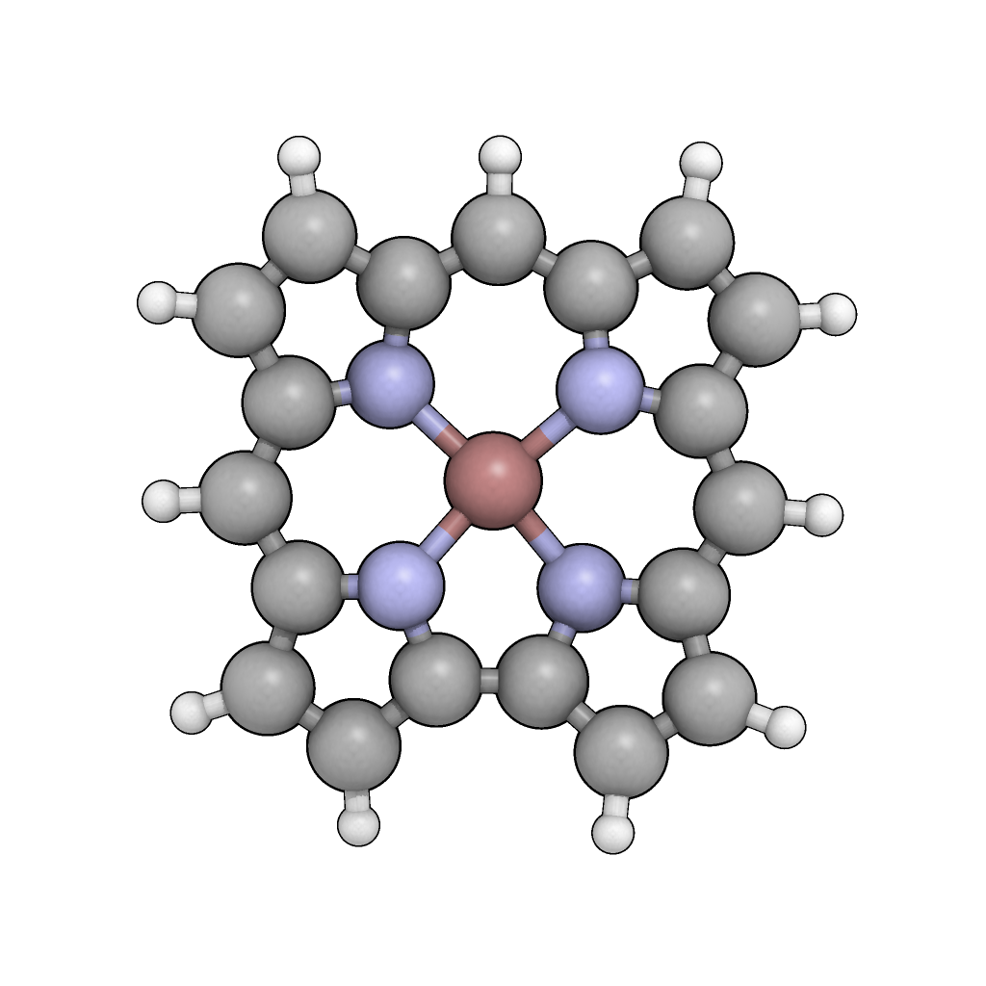
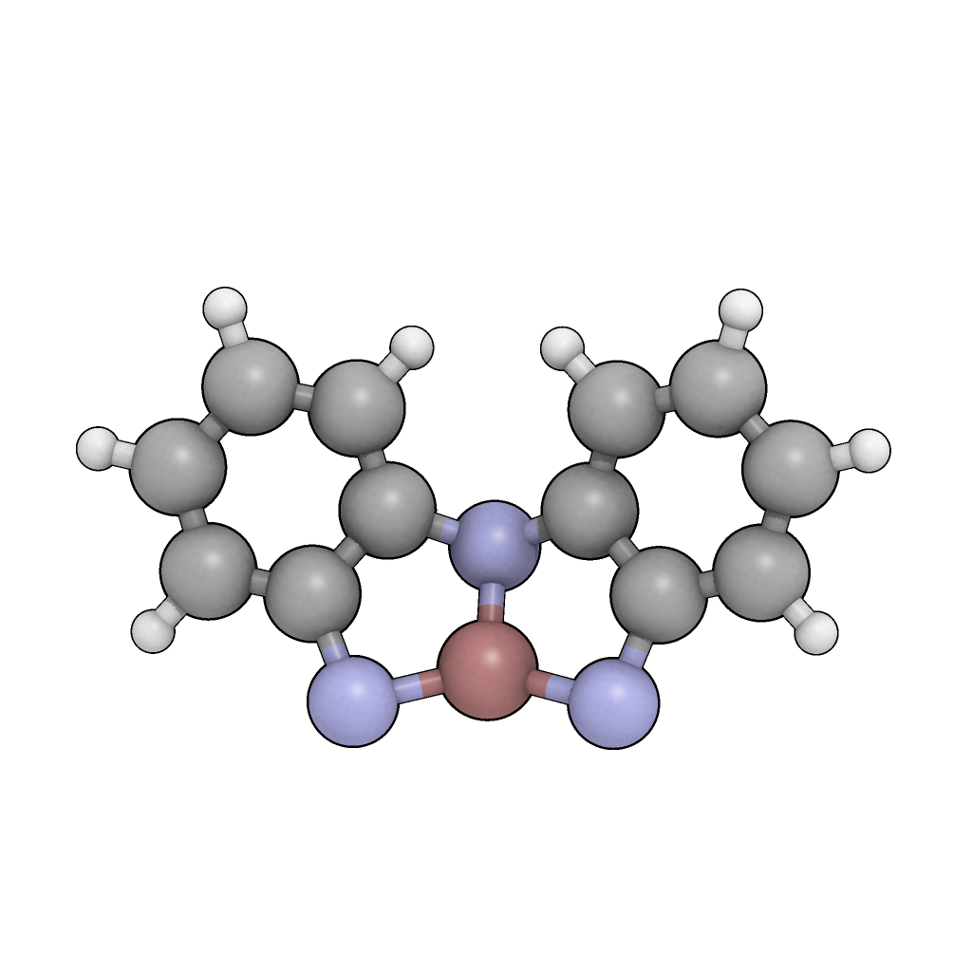
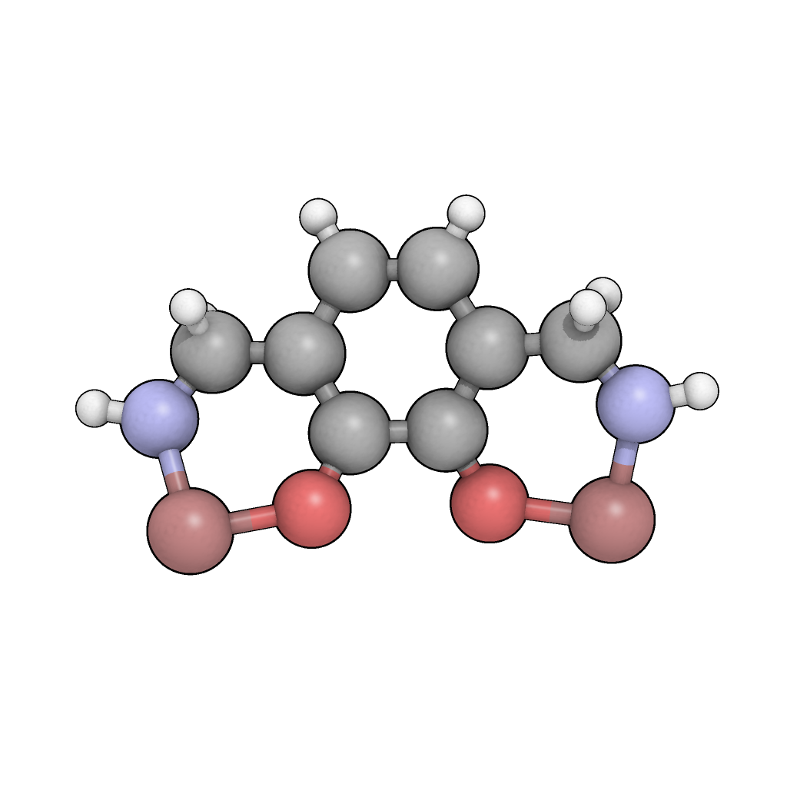
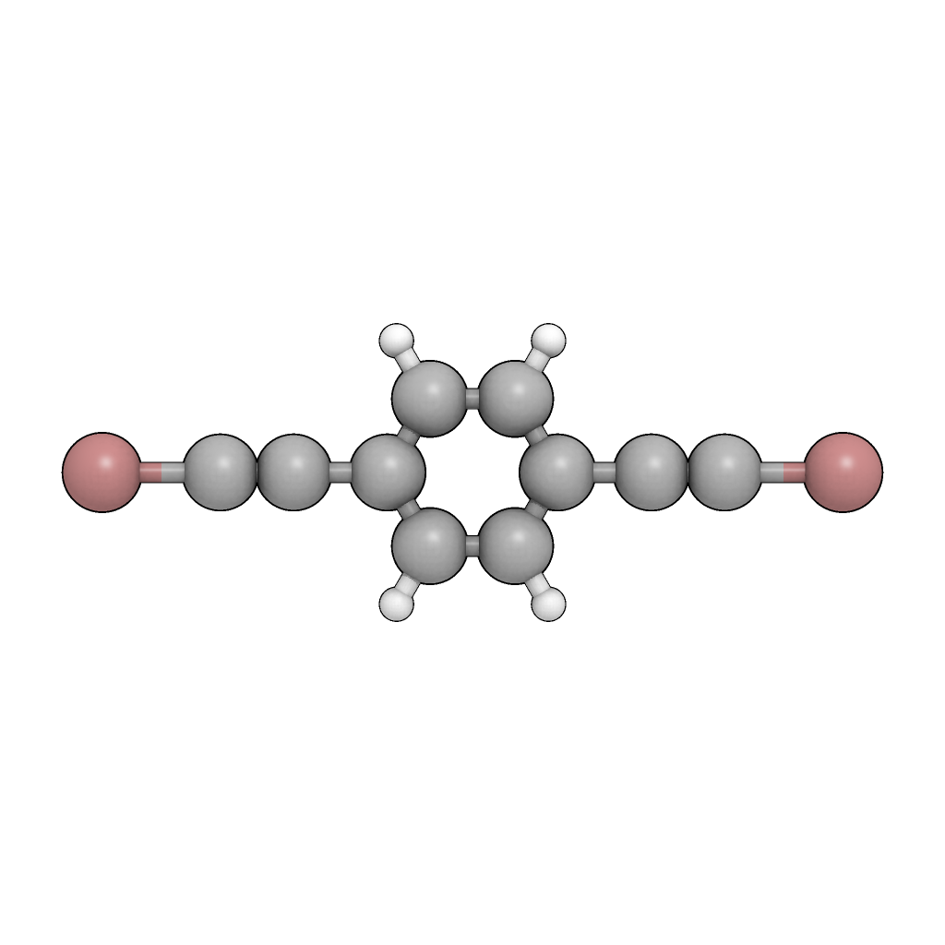

Slide 6
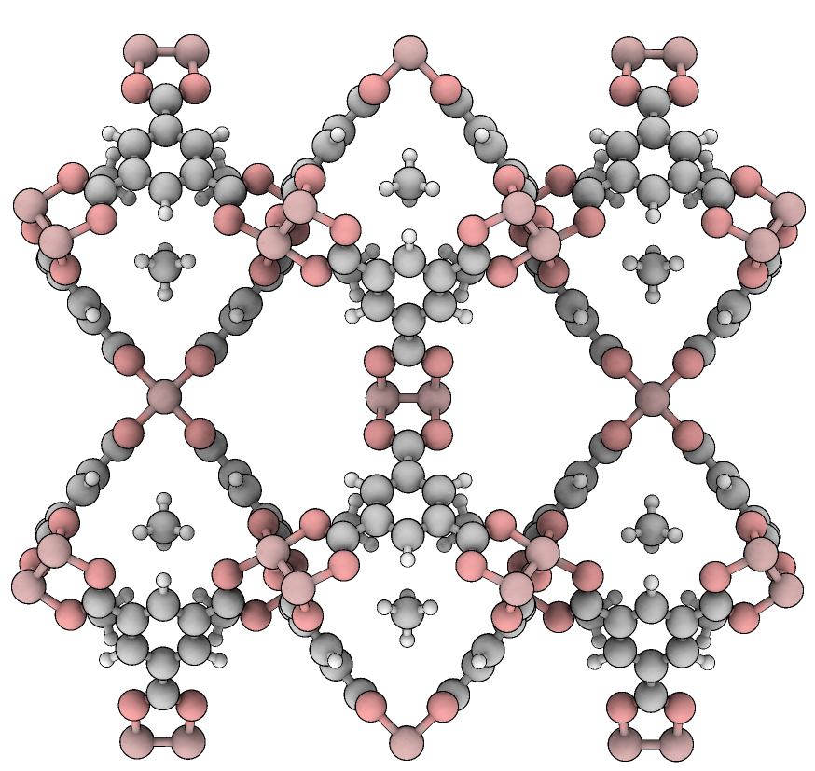

Slide 7

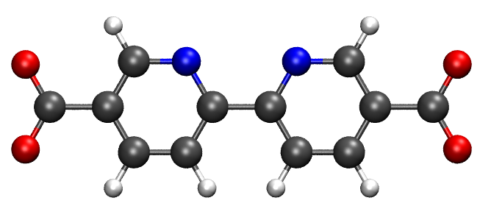
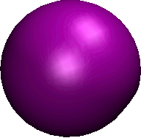
Quantum Chemical System
Calculate the interaction energy
Fit to a Force Field
Code to stream-line process
Run simulations for
pristine and NanoMOFs
Calculate Properties
Return to fitting
if not converged
✔
✗

Slide 8
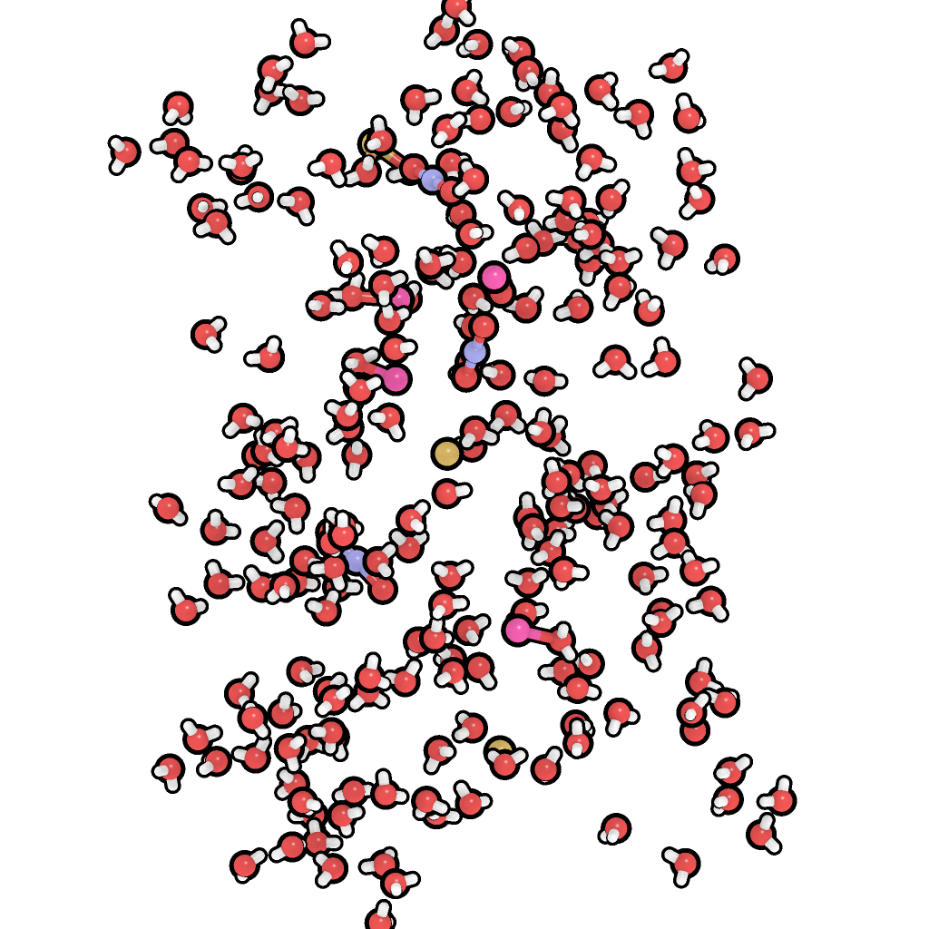
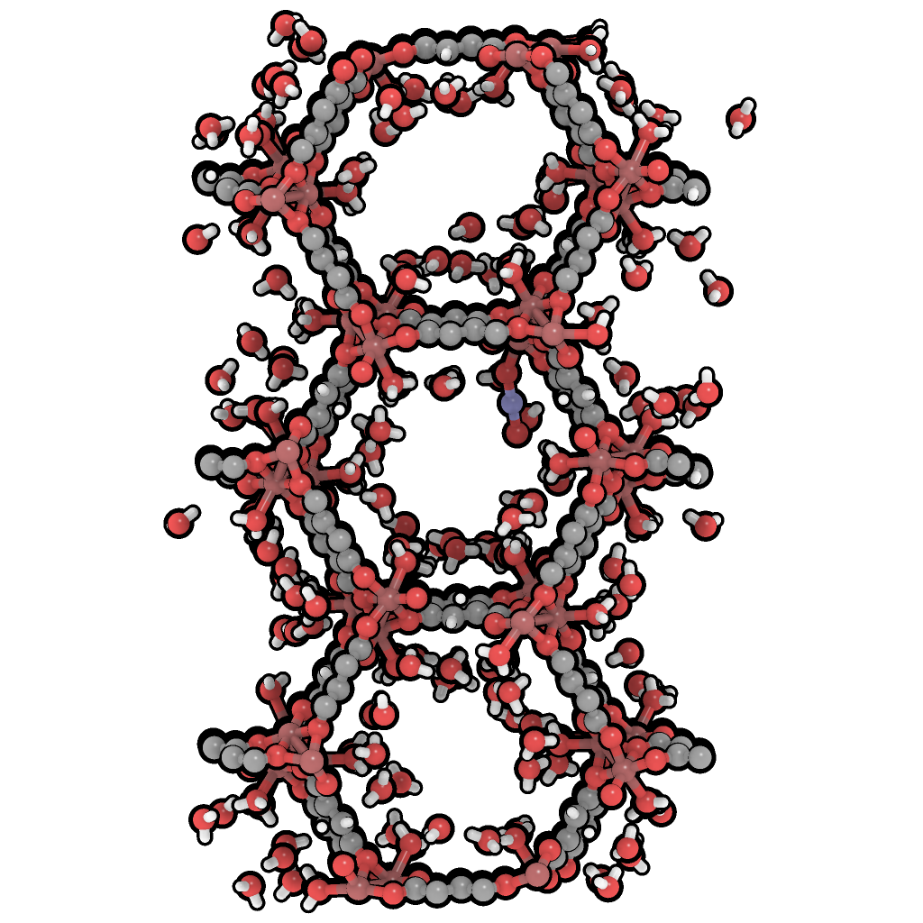
Actinyl
Other
Cation

Slide 9
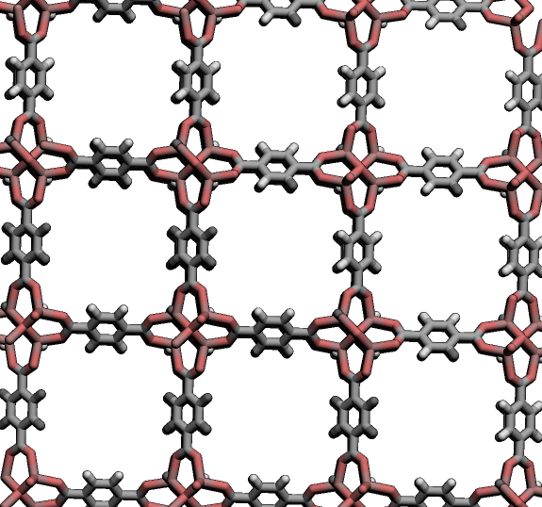
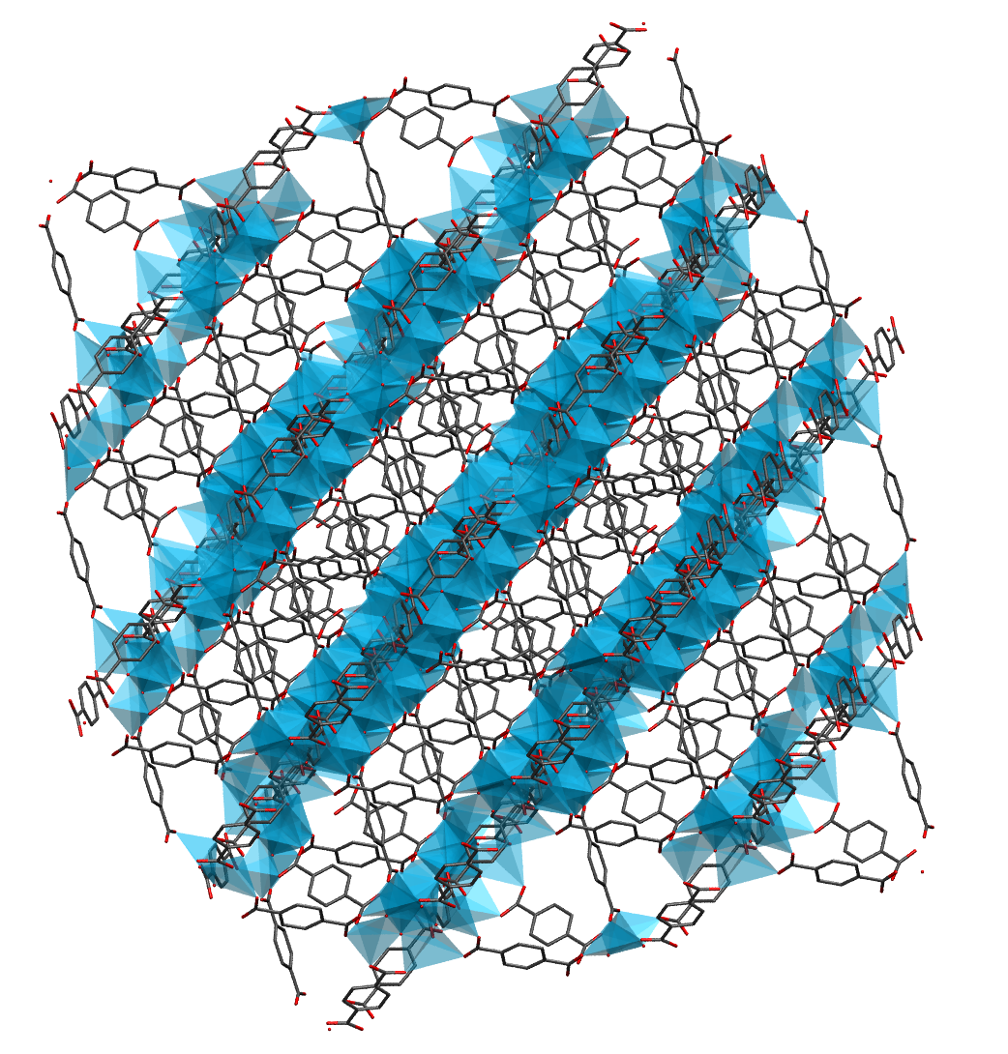
Pristine MOF
NanoMOF

Slide 10
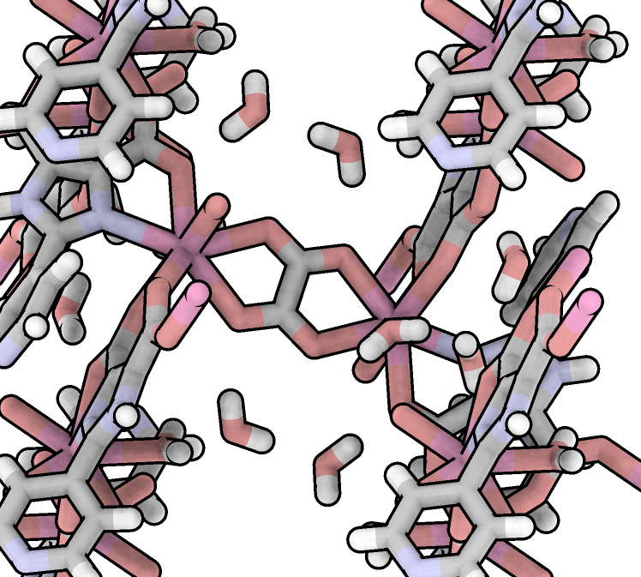

Slide 11

Ligands
Metals
Solvent
Sort Structures Based on User Input or Fit Relationships

Slide 12
Research Area 1
Research Area 2
Aim 1: Communication Between Heavy Elements
Aim 1: Trapping Heavy Elements in Solution
Aim 2: Metal Complexes with Non-Innocent Ligands
Aim 2: Molecular Sensing in MOFs
Aim 3: The Effect of the Environment on a Metal Complex
Aim 3: Defects, Surfaces, and MOF Nanoparticles

Slide 13
Electronic Structure and Excited States
Predicting and Controlling Structure
f-Element Chemistry
Aim 1: Communication Between Heavy Elements
Research
Area 1
Aim 2: Metal Complexes with Non-Innocent Ligands
Aim 3: The Effect of the Environment on a Metal Complex
Research
Area 2
Aim 1: Trapping Heavy Elements in Solution
Aim 3: Defects, Surfaces, and MOF Nanoparticles
Aim 2: Molecular Sensing in MOFs

